Slide 1
Week 1

Slide 2
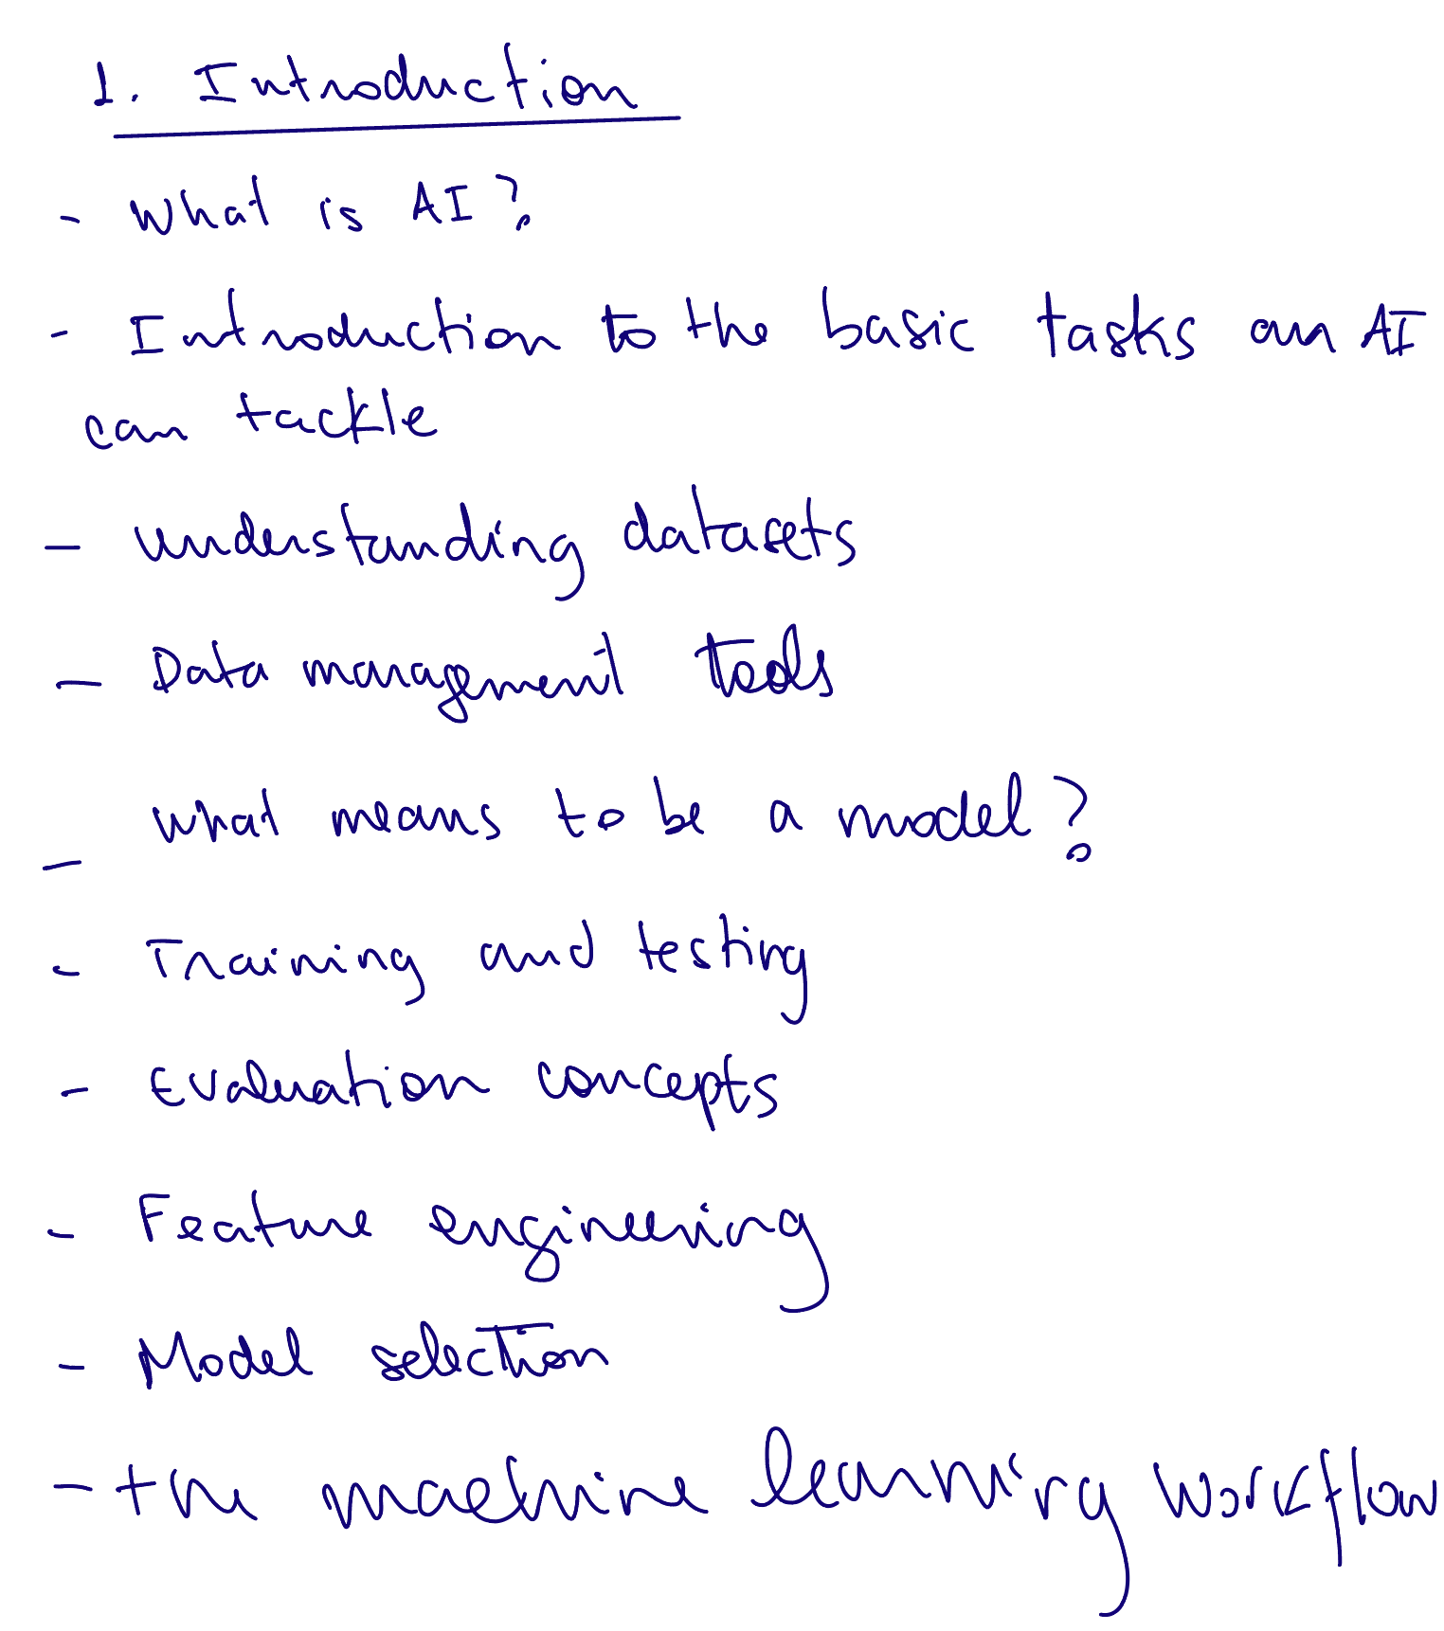

Slide 3
goals
1.Define Artificial Intelligence (AI) and explain its role in enabling machines to perform tasks that typically require human intelligence (e.g., reasoning, learning, interpreting language).
2.Understand data and the data science process and its importance for AI and for informed decision making in businesses
3.Identify the main types of machine learning — supervised, unsupervised, self-supervised, and reinforcement learning
4.Explain the steps involved in building a machine learning model, including the the relevance of features and the need for training, and test datasets for evaluation.

Slide 4
AI and Business
What is AI? Artificial intelligence (AI) is about getting computers to do things that require human intelligence
Understanding language
Reasoning
Navigating the physical world
Learning
AI is increasingly being seen as the next phase of digital transformation
Notes:
In this module, we’ll explore what artificial intelligence really means, how it learns, and how it’s being used across industries to create value. Whether it’s powering recommendation systems or optimizing logistics, AI is quickly becoming a vital part of modern business operations."

Slide 5
Internet
Cloud Computing
Mobile Computing
AI
Late 1990s
Mid 2000s
Late 2000s
Now
Notes:
Multiple digital technologies have helped transform business
Companies that were slow to react paid the price
AI is likely to be equally transformative and can potentially be viewed as a general-purpose technology

Slide 6
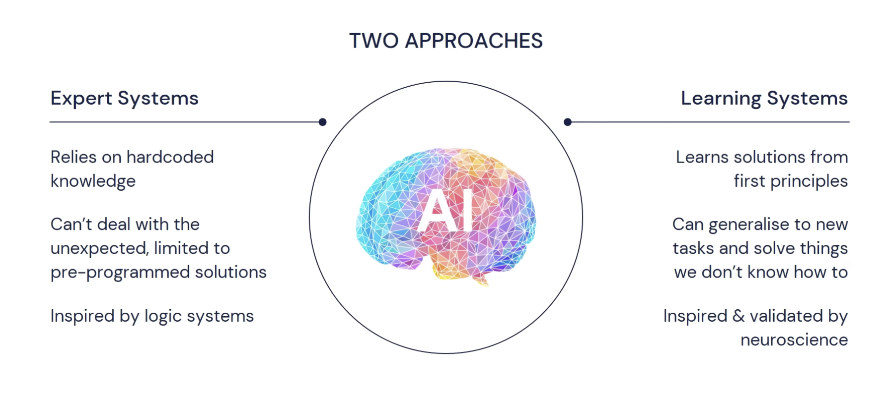
Ai is a fancy name where we want to say that a computer program would do a task a human otherwise would do
Notes:
These systems can perform tasks such as recognizing patterns, making decisions, learning from data, and adapting over time."
"Think about AI as the brainpower behind applications like Google Maps predicting traffic, or your phone unlocking with facial recognition. The goal is not just automation, but intelligent automation.”
Expert Systems (Symbolic AI / Good Old-Fashioned AI)
Accurate points:
Relies on hardcoded rules written by domain experts (e.g., IF-THEN logic).
Struggles with unexpected situations or ambiguity.
Inspired by logic and rule-based reasoning.
Business example: Early diagnostic systems in healthcare that used decision trees created by doctors. More modern examples include rule-based credit scoring engines used by banks, or eligibility checkers for insurance claims — where predefined rules determine outcomes."
"While these systems are limited in flexibility, they are still used today in regulatory environments where transparency and rule compliance are critical.”
typical chess playing
engines would be considered AI but not
machine learning because they follow
specific rules in search algorithms and
don't always learn from data
machine
learning is a branch of artificial
intelligence that enables computers to
learn from data and improve their
performance on tasks over time without
being explicitly programmed for each
task
"For example, consider a machine learning model used in online retail to predict whether a customer will make a purchase. It analyzes features like browsing behavior, time spent on product pages, and past transaction history to estimate the likelihood of conversion. This enables businesses to personalize recommendations or trigger special offers in real time. Over time, the system improves, learning from more customer interactions just like humans learn to recognize patterns after observing many examples — similar to how a salesperson gets better at gauging customer preferences through experience."
This will be mainly the focus of this course
Business example: Netflix’s recommendation engine or Google Translate.
✅ Terminology Consideration
While the terms “Expert Systems” and “Learning Systems” are clear and pedagogically sound, in technical AI literature you’ll often see:
Symbolic AI or Rule-Based AI instead of “Expert Systems”
Statistical AI or Machine Learning instead of “Learning Systems” Expert systems and machine learning are all based in computational alfgorithms. Algorithm is a set of well-defined
instructions or rules that a computer
follows to solve a problem or perform a
task algorithms are used in almost every
aspect of computing from sorting lists
and searching data to more complex
processes like encryption and data
analysis they provide step-by-step
procedures to achieve a specific goal
efficiently

Slide 7
AI and Business
implications for firms
Realize that most industries are likely to change
Notes:
To effectively leverage the opportunities, managers need to understand the technology and its applications, and make changes to their “business models, technology infrastructure, organizational processes, and culture”

Slide 8
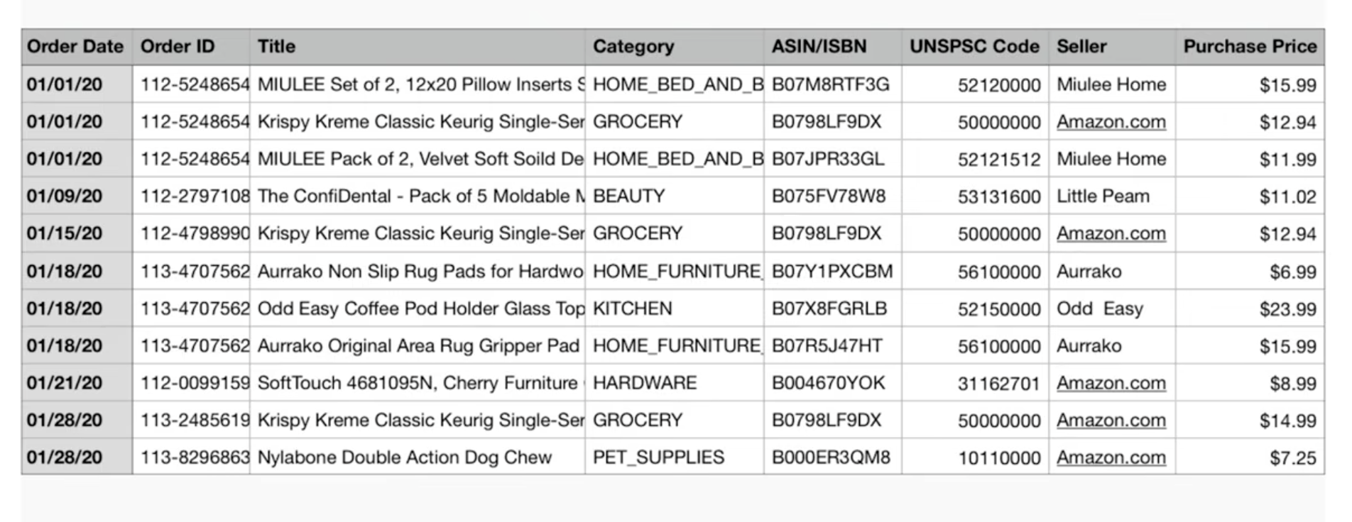
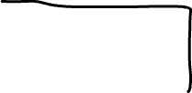



Data
Notes:
Datasets are collections of examples from which the AI learns. data typically consists of
numbers text images or any form of input
that can be processed by algorithms for
example customer purchase histories are
a type of data that e-commerce companies
analyze to recommend products likely to
interest each user another example is
weather data which includes temperature
humidity and wind speed measurements
this data is used to predict future
weather patterns in the case of images
data refers to a list of pixel
intensities and possibly colors used by
image recognition algorithms in the case
of text Data could simply be a list of
words and a text in their frequencies
data can come in many forms
But not all data is useful. High-quality, well-prepared datasets are crucial.”
"For instance, a ride-sharing app might collect data like pickup location, drop-off location, time of day, driver rating, and fare. If this data is inconsistent or missing key variables, the AI won’t learn well.”
a feature also called a predictive
variable input variable independent
variable or attribute is a specific
piece of information or characteristic
think of an
instance as one row in a data table or
spreadsheet with the columns being the
feature features

Slide 9
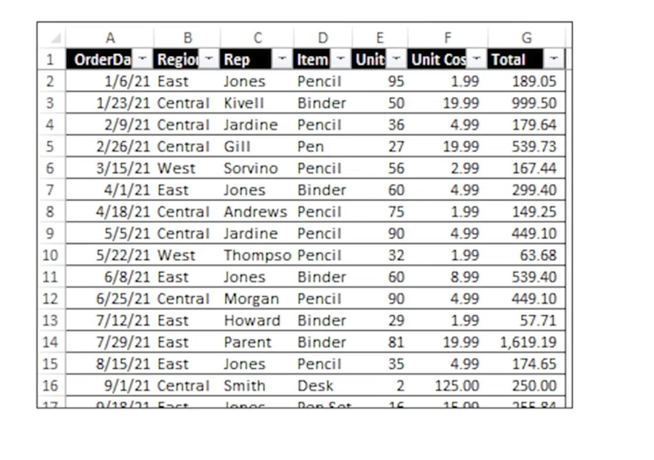
Data
Notes:
Datasets are collections of examples from which the AI learns. data typically consists of
numbers text images or any form of input
that can be processed by algorithms for
example customer purchase histories are
a type of data that e-commerce companies
analyze to recommend products likely to
interest each user another example is
weather data which includes temperature
humidity and wind speed measurements
this data is used to predict future
weather patterns in the case of images
data refers to a list of pixel
intensities and possibly colors used by
image recognition algorithms in the case
of text Data could simply be a list of
words and a text in their frequencies
data can come in many forms
But not all data is useful. High-quality, well-prepared datasets are crucial.”
"For instance, a ride-sharing app might collect data like pickup location, drop-off location, time of day, driver rating, and fare. If this data is inconsistent or missing key variables, the AI won’t learn well.”
a feature also called a predictive
variable input variable independent
variable or attribute is a specific
piece of information or characteristic

Slide 10
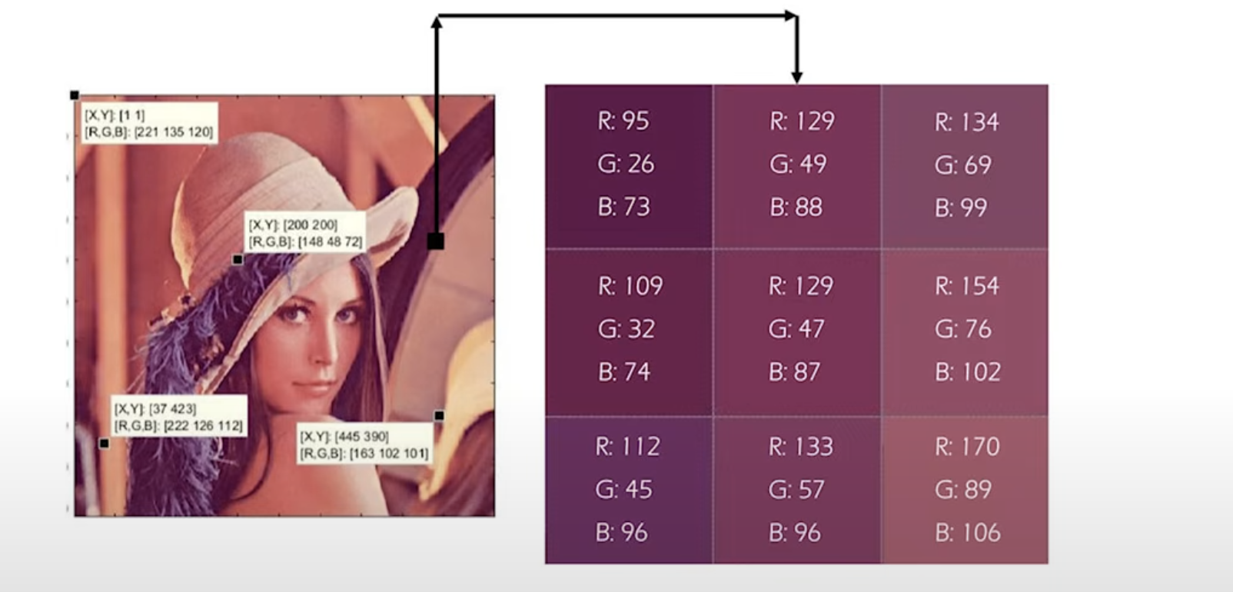


Data
Notes:
Datasets are collections of examples from which the AI learns. data typically consists of
numbers text images or any form of input
that can be processed by algorithms for
example customer purchase histories are
a type of data that e-commerce companies
analyze to recommend products likely to
interest each user another example is
weather data which includes temperature
humidity and wind speed measurements
this data is used to predict future
weather patterns in the case of images
data refers to a list of pixel
intensities and possibly colors used by
image recognition algorithms in the case
of text Data could simply be a list of
words and a text in their frequencies
data can come in many forms
But not all data is useful. High-quality, well-prepared datasets are crucial.”
"For instance, a ride-sharing app might collect data like pickup location, drop-off location, time of day, driver rating, and fare. If this data is inconsistent or missing key variables, the AI won’t learn well.”
a feature also called a predictive
variable input variable independent
variable or attribute is a specific
piece of information or characteristic

Slide 11
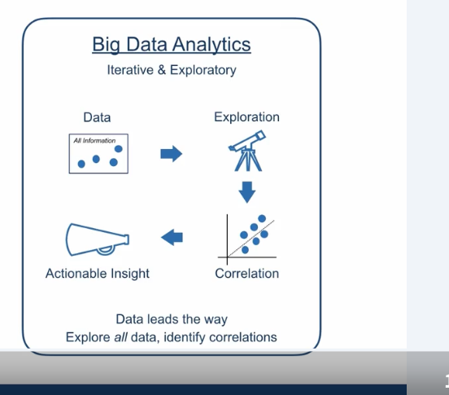
Data
The goal is to take this raw data,
and transform it into something more useful,
information, or predictions, predictions about what might happen next,
predictions that can be used in the real world.
Imagine a telecom company.
• Data Science: Collect, clean , store data, data analytics and data mining, building a machine learning model to predict which customers will churn next month and recommending retention strategies, report.
Notes:
The true value of data lies in what we can learn from it.
Data science is a multidisciplinary field, combining traditional statistics with modern methods like machine learning. Experts they apply computational techniques to identify patterns and trends. One major skill in this area is data visualization — not just for technical clarity, but to communicate insights across departments in a way that supports strategic decision-making.
Data science is about taking this raw data,
and transforming it into something more useful,
information, perhaps, or predictions, predictions about what might happen next,
predictions that can be used in the real world.
Let me give you an example. You're standing at the supermarket checkout.
Every item is recorded by the till and
at the end, you give them your loyalty card, and
they'll give you 2% off,
and you'll give them your name and address and access to all sorts of other data,
demographic data, about people like you, and so on. You've got lots of bargains today; it's
been pretty good.
Thanks to those coupons they sent you in the mail
last week, you've been able to stock up on some items that you wouldn't normally
buy, but you've bought today, because
you got some money off. And next week, they'll send you some more coupons.
They'll take this data,
they'll analyze it, they'll include data from thousands or
millions of people like you. They'll do little experiments,
to find out if they reduce the price of an item just a little bit
are you going to buy more of that? These coupons are a mechanism for
individual prices—prices set just for you.
Everyone benefits, you get a bargain, everyone loves a bargain, the supermarket
sells more stuff.
Think of a chef at work in a busy kitchen. Data mining is like picking and prepping the right ingredients—identifying the most promising elements and figuring out how they might work together. Data science, on the other hand, is the full culinary journey. It covers everything from choosing where to get the ingredients, to cooking and plating the dish, and even gauging how well it suits the diners’ preferences. While data mining equips you with the raw materials and initial insights, data science brings everything together into a well-executed and meaningful experience.
Imagine a telecom company.
• Data Mining: Discovering that customers who call customer service more than 3 times in a month are likely to churn.
• Data Analytics: Reporting this trend in a dashboard to understand churn patterns.
• Data Science: Building a machine learning model to predict which customers will churn next month and recommending retention strategies.
The distinction isn’t always rigid. For example, some data analytics roles now include predictive elements (e.g., forecasting sales trends), and data scientists often rely on analytics to validate their models. Additionally, the tools and skills (e.g., SQL, Python, or statistical methods) can overlap significantly between the two fields.
•

Slide 12
Add types of analytics?

Slide 13
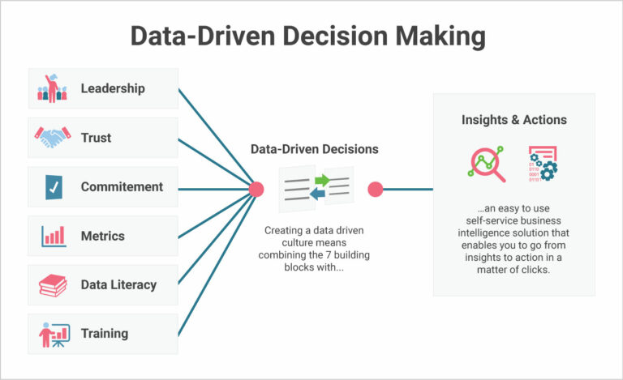
Notes:
But data insights are only useful if someone acts on them. This is where managers step in. Managers need to interpret findings, ask the right questions, and apply insights to real business problems. This requires two important skill sets: basic data literacy and domain expertise. They don’t need to be coders, but they do need to understand what the analysis implies — and when to question it. After all, not every pattern in data is meaningful. Spurious correlations are common, and acting on them without proper scrutiny can lead to costly mistakes. That’s why managers need to understand both the capabilities and limitations of data analysis.
So, often companies have roles like data architects and scienctis come in. These professionals don’t just manage the data flow — they shape governance policies and design the digital infrastructure that determines whether data resides on-premises or in the cloud.
Equally important is contextual knowledge — industry know-how that helps bridge the gap between statistical outputs and strategic choices. Managers with strong subject-matter knowledge and a working understanding of analytics can transform raw insights into intelligent action.
Data management tools – technologies for capturing, storing, and organizing enterprise data.
Analytical tools – platforms and techniques that support data analysis and help turn complex datasets into decisions.
"Big Data analytics, however, flips the script. It’s iterative and exploratory.
"It’s important to understand how Big Data has changed the way You start with all available data, explore it, and let correlations or insights emerge — often discovering questions you hadn’t even thought to ask."
"This shift has opened up new opportunities for AI, because algorithms can now explore massive, high-dimensional datasets and fin

Slide 14
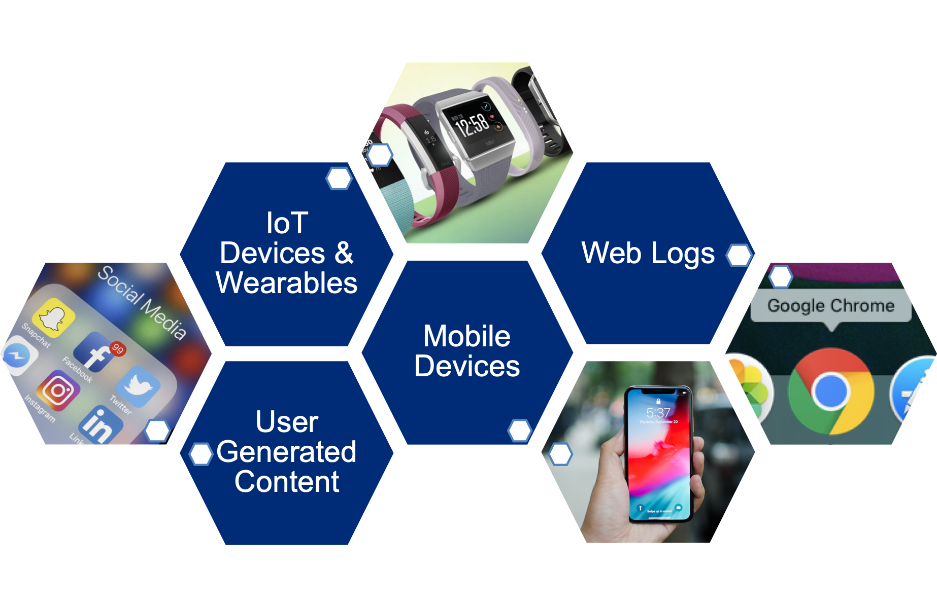
Drivers of Big Data
Computing capacity: the capacity to store data has increased and the associated cost has decreased
Data generation: the world is going digital, more people and things are connected than ever before
Content/quotes from: “Big Data” by Victor Mayer- Schonberger and Kenneth Cukier, Images: https://www.axios.com/fewer-people-use-facebook-for-news-13273e71-ab51-49cc-b4ee-1588a241c0c8.html, https://www.imore.com/best-fitbit, https://www.digitaltrends.com/cell-phone-reviews/apple-iphone-xs-review/
Notes:
Modern AI applications often depend on what we call Big Data. Two key drivers of Big Data are:
Computing Capacity – The ability to store and process large volumes of data has grown dramatically, while costs have dropped.
Data Generation – Thanks to mobile devices, wearables, social media, and IoT, we’re generating more data than ever before."
Every time we check out an item at the supermarket,
every time we swipe our credit card, every time we send an email,
every time we type a keystroke on our keyboard. Every time we make a phone call, send a text, walk past
a security camera.
We all generate a little bit of data.

Slide 15
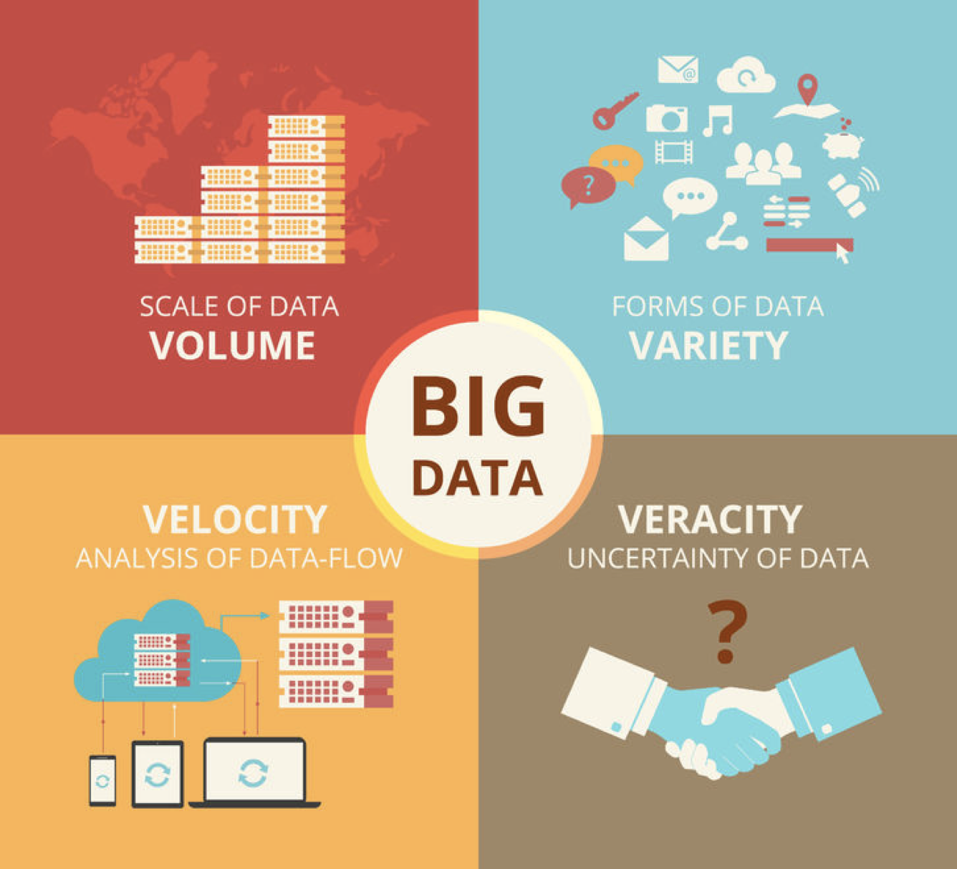
Big Data Characteristics
New data characteristics created by today’s digitized marketplace
“Terabytes to petabytes of existing data to process”
“Structured, unstructured, text, multimedia”
“Streaming data, milliseconds to seconds to respond"
“Uncertainty due to data inconsistency & incompleteness, ambiguities, latency, deception, model approximations”
Image from: https://www.cbpr.me/big-data-and-public-relations/4vs/
Additional quotes from another diagram found at https://www.datasciencecentral.com/profiles/blogs/data-veracity
Notes:
"Big Data is also characterized by what’s called the 4 Vs:
Volume: We're dealing with terabytes to petabytes of data.
Velocity: Data is streaming in real time, requiring immediate processing.
Variety: Data comes in many forms — structured, unstructured, text, images, video.
Veracity: Data can be messy, inconsistent, or incomplete, creating uncertainty."
"These characteristics make data more powerful — but also more complex to manage and analyze."
If you want to know more about big data and its challenges in business infrastructure and also its computational challenges chek out ..

Slide 16


Notes:
"In business, managing data means collecting, cleaning, storing, transforming and extracting knowledge or insights from the data.
The initial step to accomplish this is trough databases. Databases are structured collections of data, where several datasets can be found and where information retrieval is possible
Companies use tools to manage their databases such as SQL databases, Python libraries like pandas, or big-data platforms like Snowflake or Databricks.
Operations databases are usually fast and stored locally for each operation of a company while comprehensive databases, those that have more historical data and aggregate several operations are usually sorted in what we call data warehouses.
"Think about Airbnb. Every booking, review, photo, and location is part of their data pipeline. They use this data to recommend listings, adjust prices, and flag fraudulent activity.”
If you want to know more about Datawarehouse, DBMS and other big data tools form a business information system’s perspective, check out xxx for more resources.
When a air bnb customer logins ins and see past bookings, a operations data based is accessed.But also , in an analytics stand point, air bnb has storical data from all operations sitting in bigger datawarehouses. These big data warehouses bacuese they are centralized and also carry historical information can be used to the purpose of datascience.
Data science is a multidisciplinary field, combining traditional statistics with modern methods like machine learning. Experts they apply computational techniques to identify patterns and trends. One major skill in this area is data visualization — not just for technical clarity, but to communicate insights across departments in a way that supports strategic decision-making.
Data science is about taking this raw data,
and transforming it into something more useful,
information, perhaps, or predictions, predictions about what might happen next,
predictions that can be used in the real world.
Let me give you an example. You're standing at the supermarket checkout.
Every item is recorded by the till and
at the end, you give them your loyalty card, and
they'll give you 2% off,
and you'll give them your name and address and access to all sorts of other data,
demographic data, about people like you, and so on. You've got lots of bargains today; it's
been pretty good.
Thanks to those coupons they sent you in the mail
last week, you've been able to stock up on some items that you wouldn't normally
buy, but you've bought today, because
you got some money off. And next week, they'll send you some more coupons.
They'll take this data,
they'll analyze it, they'll include data from thousands or
millions of people like you. They'll do little experiments,
to find out if they reduce the price of an item just a little bit
are you going to buy more of that? These coupons are a mechanism for
individual prices—prices set just for you.
Everyone benefits, you get a bargain, everyone loves a bargain, the supermarket
sells more stuff.
"Data analytics focuses on understanding past performance — it’s about reporting, summarizing, and making sense of what already happened. Think of dashboards, trend charts, and descriptive statistics. A marketing analyst reviewing campaign metrics falls into this category."
"Data science, however, is more forward-looking. It involves predictive modeling, algorithm development, and automation. A data scientist might build a recommendation system, predict customer churn, or optimize logistics — often using machine learning techniques."
"One way to remember the distinction: analytics explains, science predicts and builds.”
Imagine a telecom company.
• Data Mining: Discovering that customers who call customer service more than 3 times in a month are likely to churn.
• Data Analytics: Reporting this trend in a dashboard to understand churn patterns.
• Data Science: Building a machine learning model to predict which customers will churn next month and recommending retention strategies.
The distinction isn’t always rigid. For example, some data analytics roles now include predictive elements (e.g., forecasting sales trends), and data scientists often rely on analytics to validate their models. Additionally, the tools and skills (e.g., SQL, Python, or statistical methods) can overlap significantly between the two fields.

Slide 17





Machine learning Model
inputs
outputs
Notes:
A feature is any measurable attribute or piece of information used by a machine learning model to make predictions. Think of it as an input variable that helps the model understand the problem it's trying to solve. For instance, in a model designed to estimate house prices, features might include things like the home’s size in square feet, the number of bedrooms and bathrooms, its location, and the age of the property.
a model in
machine learning is a mathematical
representation that is trained to
recognize patterns in data and make
predictions or classifications based on
those patterns the most common type of
model is simply a mapping function
between a an input and an output
for an
email spam detector features could
include the number of capitalized words
the number of URLs in the text or
whether the sender is in your contacts
the selection and Engineering of
relevant features sometimes called
feature extraction or feature design is
often crucial to a model success as they
need to capture the important aspects of
the data that relate to the prediction
task
in machine learning algorithms
identify patterns and relationships
within data making predictions or
decisions based on new unseen
information
"At the heart of all AI is data. I would say that Data is the fuel for AI.

Slide 18
Four Types of Machine Learning
Supervised Learning
Develop predictive model based on input and output data
Classification
Regression
Unsupervised Learning
Group and interpret observations based only on input data
Anomaly Detection
Clustering
Self-Supervised Learning
Learn internal structure of data by generating pseudo-labels from the data itself
Classification, regression and NLP tasks
Reinforcement Learning
Acquire new data by taking actions and receiving ad hoc feedback
Optimization
Notes:
Let’s talk about four main types of learning under AI: supervised, unsupervised, self-supervised, and reinforcement learning."
"Supervised learning is when we train a model using labeled data — where we tell the machine what the correct answers are. This is like teaching a student with an answer key."
"Unsupervised learning is the opposite — no labels, just raw data. The model has to figure out patterns or clusters on its own."
"Self-supervised learning is in between — the model creates its own labels from the data. For example, hiding a word in a sentence and asking the model to guess it."
"And reinforcement learning is when an AI system learns by interacting with its environment — like a video game character that gets points for doing well and penalties for doing poorly."

Slide 19
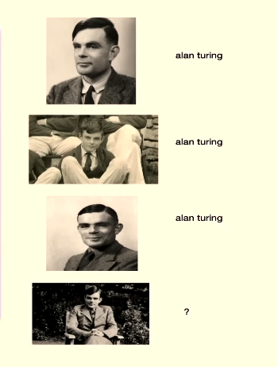

Supervised learning
Requires labeled data
Input and output data
Classification task
Tesla autopilot
Recognizing tumors in Xray
Rain or no rain
training
test
Notes:
supervised learning is a foundational
approach in machine learning where
models learn from labeled examples
meaning the true outcomes or targets are
known and provided much like a student
learning from problems with their
answers provided each example in the
training data includes both of the input
and the correct output allowing the
model to learn the relationship between
them for instance an image recognition
system would train on images that have
been pre-labeled with their contents
such as dog or cat this is arguably the
most common type of machine learning
probably making up around 70% of machine
learning applications

Slide 20







Supervised learning
Requires training data
Input and output data
Classification task
Tesla autopilot
Recognizing tumors in Xray
Rain or no rain
H | P | LABEL
1.2 | 1 | rain
1.2 | 2.4 | no rain
1.5 | 3 | no rain
1.7 | 4.3 | rain
1.31 | 2.0 | ?
training
test
Notes:
a label also called a class Target
value ground truth or correct answer is
the known correct output associated with
an instance in supervised learning it is
the value that the target variable takes
for each instance
in an image
recognition system where the target
variable is the type of animal in the
picture the label is the actual animal's
name like cat or dog for each image

Slide 21
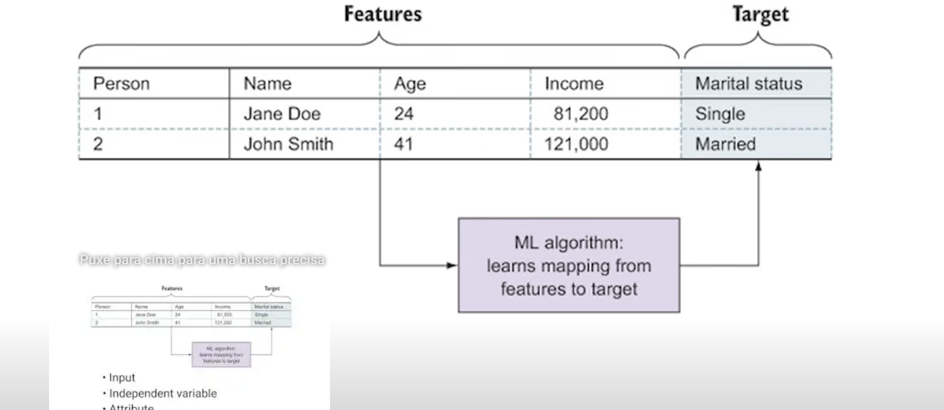




Slide 22
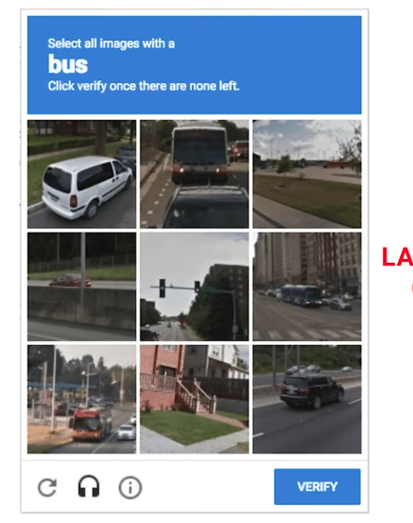
Notes:
this process is
called labeling which often is a major
bottleneck in supervised learning
well-labeled data is a hot commodity and
many creative ways exist to generate it
including crowdsourcing

Slide 23





Slide 24
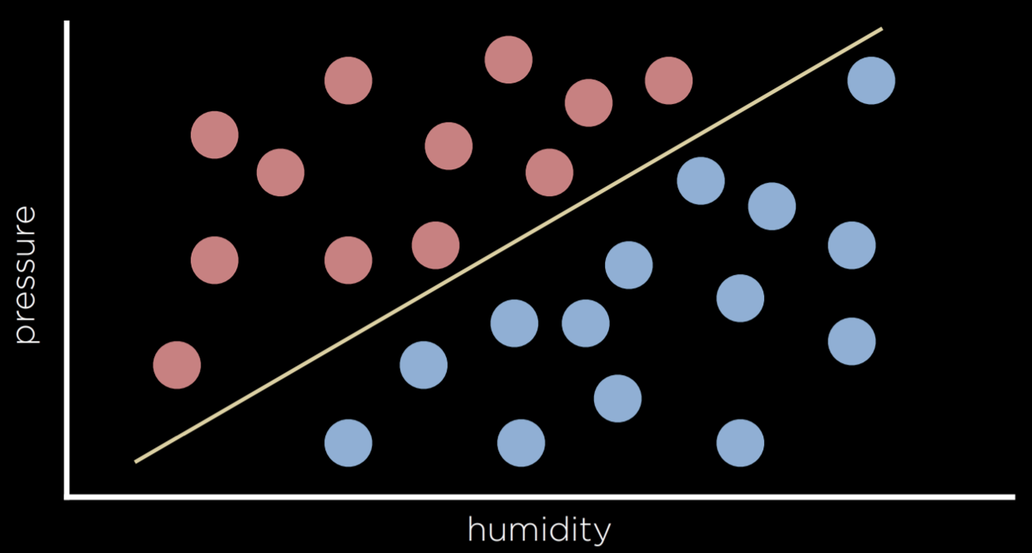



Slide 25



Slide 26


Slide 27
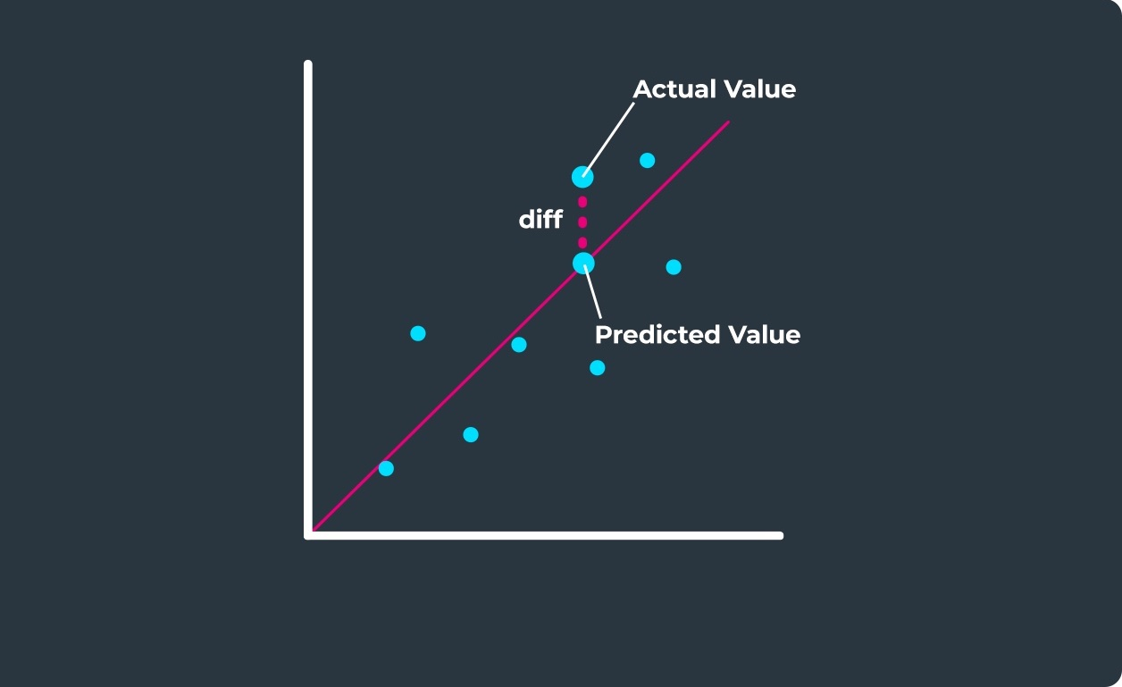












Supervised Learning
Light advertisement | Aggressive Adv | Sales
0.45 | 0.75 | 1.2
0.12 | 0.82 | 1.2
0.34 | 0.34 | 1.5
0.47 | 0.47 | 1.7
Requires labeled data
Input and output data
Regression task
Function fitting in marketing
Amount of CO2 given consumer habits
Notes:
Regression is a supervised learning task , this is , we will explore our model to data .
But now, the our model should map an input point to a continuous value, some real number. This differs from classification in that classification problems map an input to discrete values (Rain or No Rain).
For example, a company might use regression to answer the question of how money spent advertising predicts money earned in sales. In this case, an observed function f(advertising) represents the observed income following some money that was spent in advertising (note that the function can take more than one input variable). These are the data that we start with. With this data, we want to come up with a hypothesis function h(advertising) that will try to approximate the behavior of function f. OUr model, will generate a line, so we can use again the perceptron, whose goal is not to separate between types of observations, but to predict, based on the input, what will be the value of the output.

Slide 28
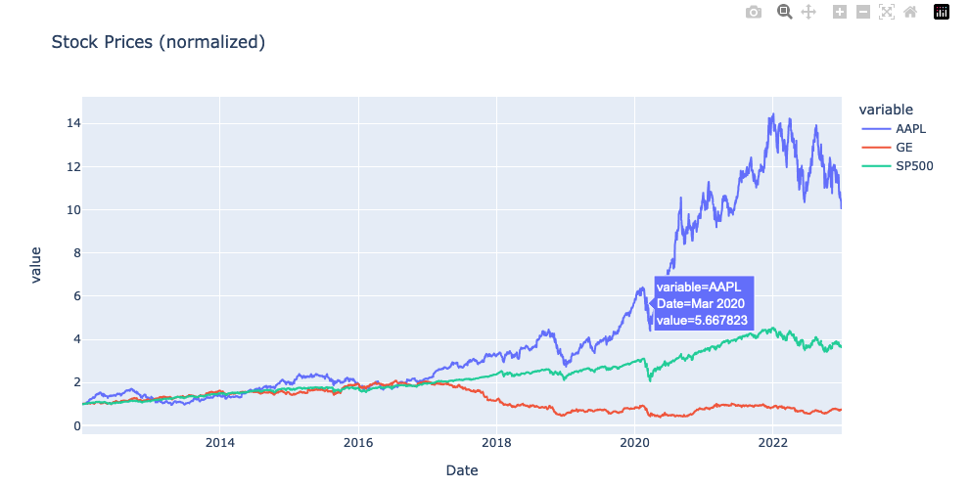


Supervised Learning
Requires labeled data
Input and output data
Forecasting
 | x₁ | x₂ | x₃ | starget
t = 4 | x(3) | x(2) | x(1) | x(4)
t = 5 | x(4) | x(3) | x(2) | x(5)
t = 6 | x(5) | x(4) | x(3) | x(6)
t = 7 | x(6) | x(5) | x(4) | x(7)
t = 8 | x(7) | x(6) | x(5) | x(8)
Notes:
Forecasting is one of the most powerful applications of supervised learning. It involves using historical data to predict future outcomes. In this setup, the model is trained on examples where both the input (such as time, sales volume, or weather conditions) and the correct output (such as actual sales or demand) are known."
"Once the model learns the relationship between inputs and outputs, it can then be used to predict future values where the output is not yet known."
"For example, a telecom company might use supervised learning to forecast monthly customer churn. The inputs could include customer tenure, usage patterns, call center complaints, and payment history, and the model would be trained to predict whether a customer will leave the service in the next month."
"Forecasting can apply to sales, demand, inventory, or even energy consumption — and it is a key business driver in many industries that rely on planning and resource allocation."

Slide 29
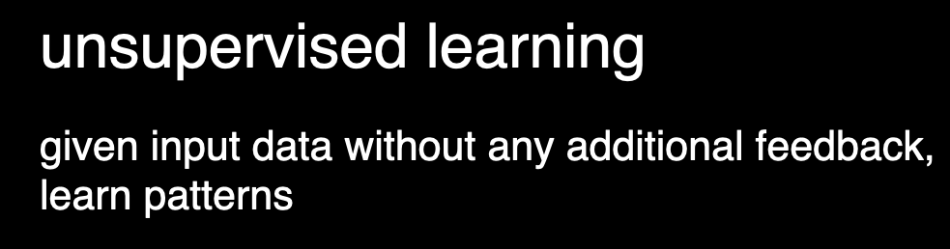

UNSUPERVISED LEARNING
CLUSTERING

Slide 30
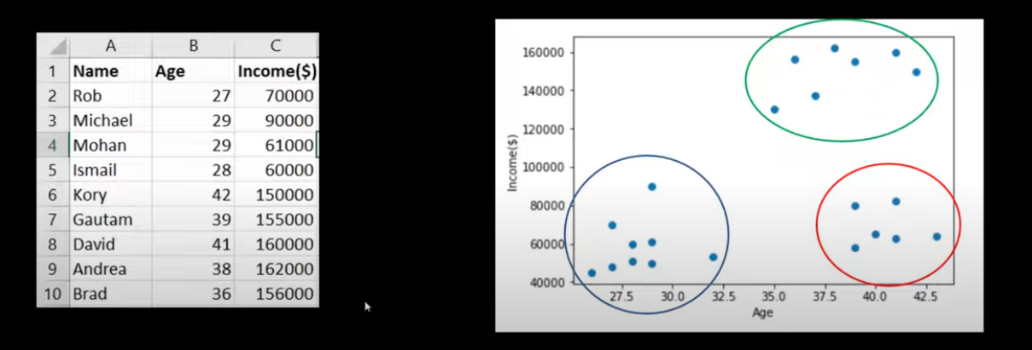



UNSUPERVISED LEARNING
CLUSTERING
Notes:
unsupervised
learning is a type of machine learning
where models learn to find patterns and
structure in data without being given
labeled examples or correct answers
rather than being taught what to look
for these algorithms discover natural
groupings and relationships within the
data on their own for example
an
unsupervised learning algorithm might
analyze customer purchase data to
identify groups of customers with
similar buying habits or examine social
media posts to discover trending topics
all without being told in advance what
patterns to look for this approach is
particularly valuable when we want to
explore data to uncover hidden patterns
but don't know exactly what we're
looking for
No Labels or outcomes are
provided to the model during training

Slide 31
REINFORCEMENT LEARNING
OPTIMIZATION
Notes:
reinforcement learning is a newer branch
of machine learning that has recently
been accepted as a third main branch of
machine learning and has gain momentum
in the late 2010s particularly with the
success of deep Minds chess engine
alphago in 2016 it's distinct from both
supervised and unsupervised learning
because it operates on a fundamentally
different principle instead of learning
from pre-labeled examples supervised or
finding patterns in unlabeled data
unsupervised
it learns from interaction
and feedback reinforcement learning is more like
training a pet and is very related to the way humans learn.
the agent learns through
trial and error getting rewarded for
good decisions and penalized for poor
ones for example
a reinforcement
learning algorithm can learn to play
Tik tak toe by playing thousands of games
against receiving positive
rewards for winning moves and negative
rewards for bad ones
this approach is
particularly powerful for tasks
involving sequential decision-making
like gam playing robotic control or
optimizing business strategies when
there are no clear labels but an idea of
what is a good or bad outcome many basic
machine learning courses don't cover
reinforcement learning as a basic
machine learning Branch but as an
advanced topic since it is still fairly
Niche

Slide 32
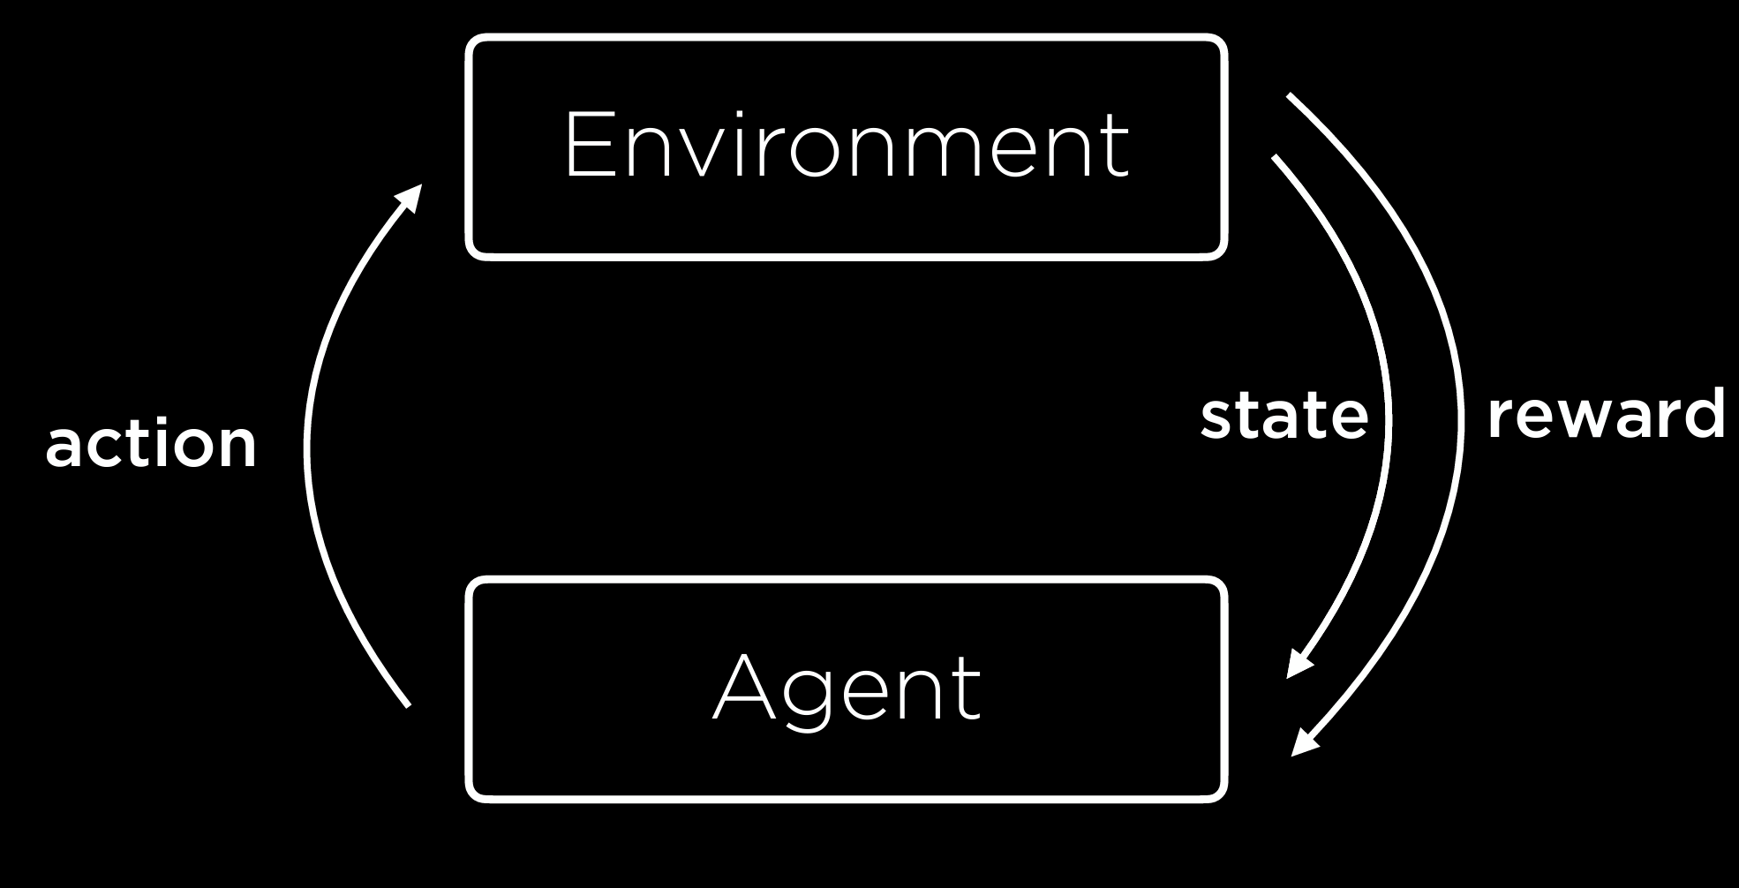
Notes:
LEARNING IS HELD BY LEARNING FROM EXPERIENCE AS. ARESULT OF RANDOM EXPLORATION OF THE AGENT.

Slide 33
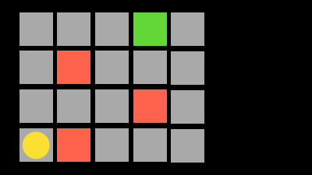
Notes:
For example, the yellow agent news to achieve the green square.

Slide 34
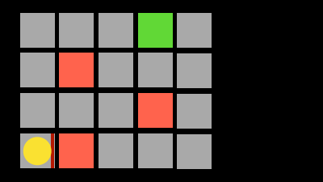
Notes:
Eventually the agent will bump into a wall, represented here by the red square and will receive a small reward or punishment, enabling him to learn from this experience that going to the right is not a possible action when being in this particular state.

Slide 35
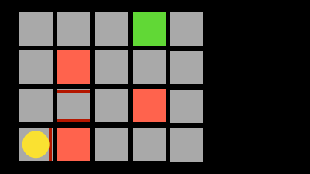
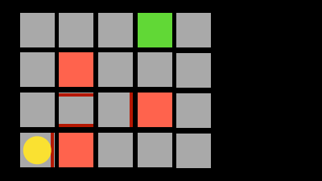
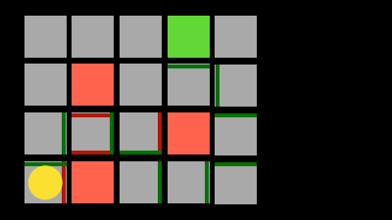




Slide 36
Notes:
model for decision-making, representing states, actions, and their rewards

Slide 37





Notes:
And eventually he will find an trajectory that takes him to the goal. And the reward once it gets to the goal there is bigge.
the trajectory is locally optimal because the it is dependent on how much exploration the agent did. We call this mapping from what action to take given a state a policy.

Slide 38
SELF SUPERVISED LEARNING
NLP TASKS, text summarization,
Translation,
Questions and answers
Sentiment analysis (classification)
Image and video generation

Slide 39
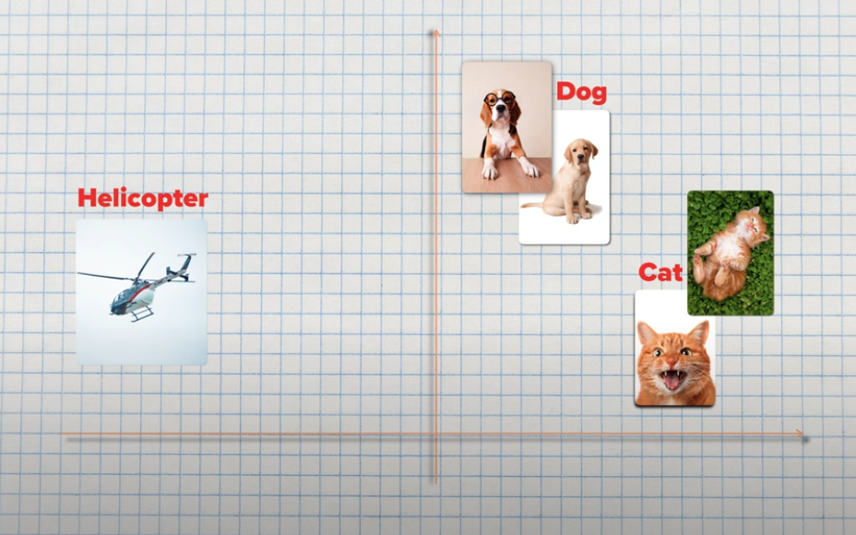
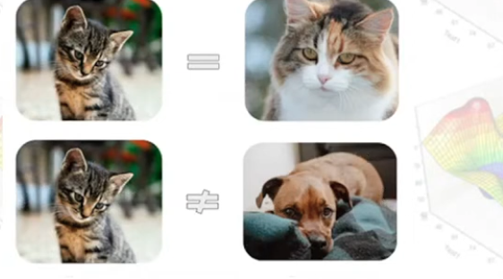
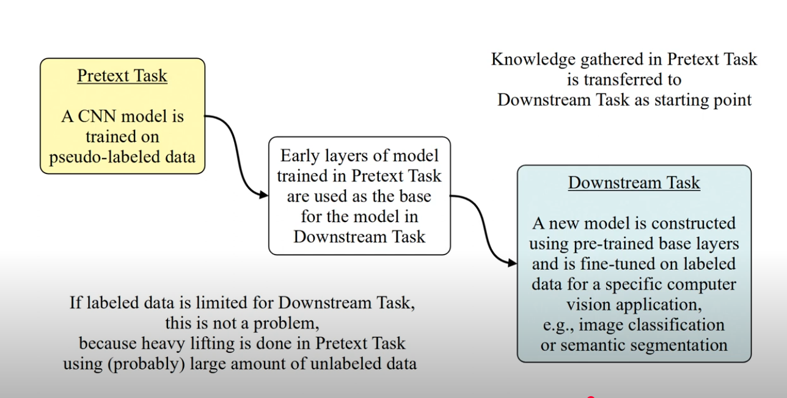










Slide 40
Method | Needs Human Labels? | Learns From | Example Task | Core Idea
Supervised Learning | ✅ Yes | Input + human-provided labels | Predict customer churn (Yes/No) | Learn a mapping from inputs to correct outputs
Unsupervised Learning | ❌ No | Raw data | Cluster similar users based on behavior | Find hidden patterns or groups
Self-Supervised Learning | ❌ No | Raw data + generated pseudo-labels | Predict missing word in a sentence | Predict parts of data using other parts
Reinforcement Learning | ❌ No (but needs feedback signal) | Trial and error, reward feedback | Teach a chatbot to respond more helpfully | Learn by interacting with an environment

Slide 41
How to avoid overfitting and underfitting
Holdout Validation and cross-validation
Regularization – a modification to the algorithm penalizing the model of being to complex or to simple.
Notes:
one way avoid
underfitting and overfitting before
applying your model to real world data
is validation
validation is the practice
of evaluating a model's performance on
data it hasn't been trained on by
setting aside a portion of the training
data called the validation set to
simulate how well the model will perform
on new unseen data
cross validation
extends this concept by repeatedly
training and validating the model on
different splits of the data for example
in five-fold Cross validation the data
is divided into five parts and the model
is trained five times each time using a
different part as the validation set and
the remaining parts for training this
practice provides a more robust estimate
of the model's True Performance and
helps detect potential issues like
overfitting or underfitting
while
validation sets are used during the
model development process to make
decisions about hyperparameters and
model selection the test set is kept
completely separate and used only once
at the very end to evaluate the final
model's performance using the test set
repeatedly would risk overfitting to it

Slide 42
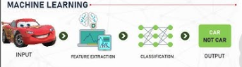
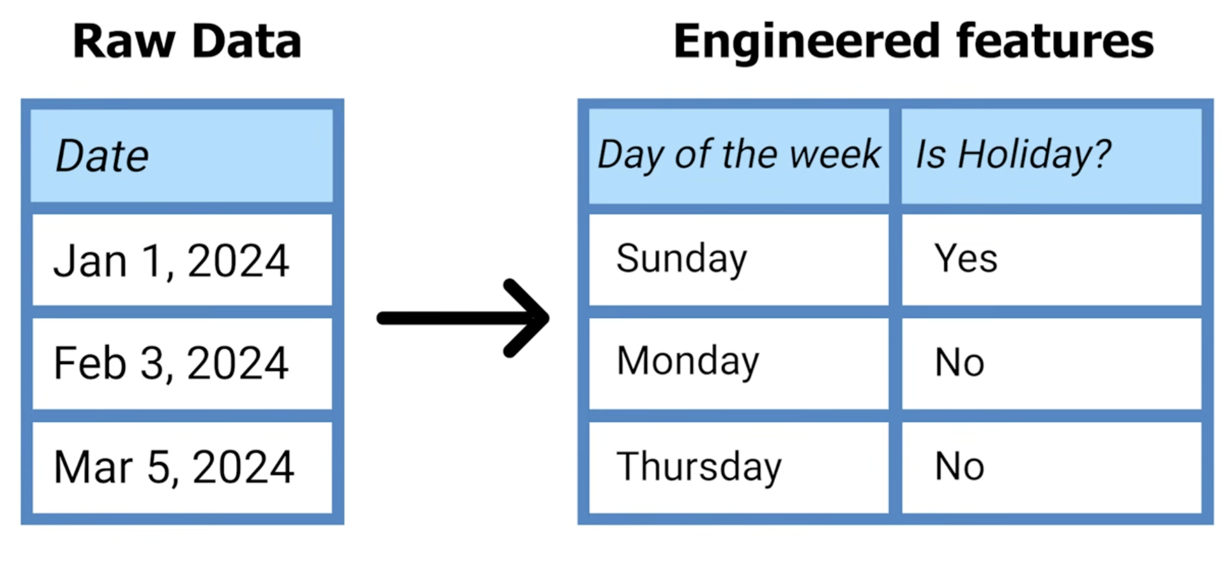
Notes:
the selection and Engineering of
relevant features sometimes called
feature extraction or feature design is
often crucial to a model success as they
need to capture the important aspects of
the data that relate to the prediction
This selction can be do by experts or by using machine learning algorithms and statistical algorithms
task feature engineering is the process
of creating new more informative
features from existing raw data to
improve a model's performance feature
engineering involves using domain
knowledge and creativity to transform or
combine original features into more
meaningful ones for for example instead
of just using raw date values you might
create features like day of the week or
is holiday which will probably explain
fluctuations of sales much better good
feature engineering often makes the
difference between an average model and
an excellent one as it helps the model
focus on the most relevant patterns in
the data

Slide 43
When data are not structured, features have to be “engineered” from the data
A time-consuming and challenging process, and often requires domain expertise
One of the most difficult parts of the ML process, where data scientists spend a lot of their time
Can be as much an art as a science

Slide 44
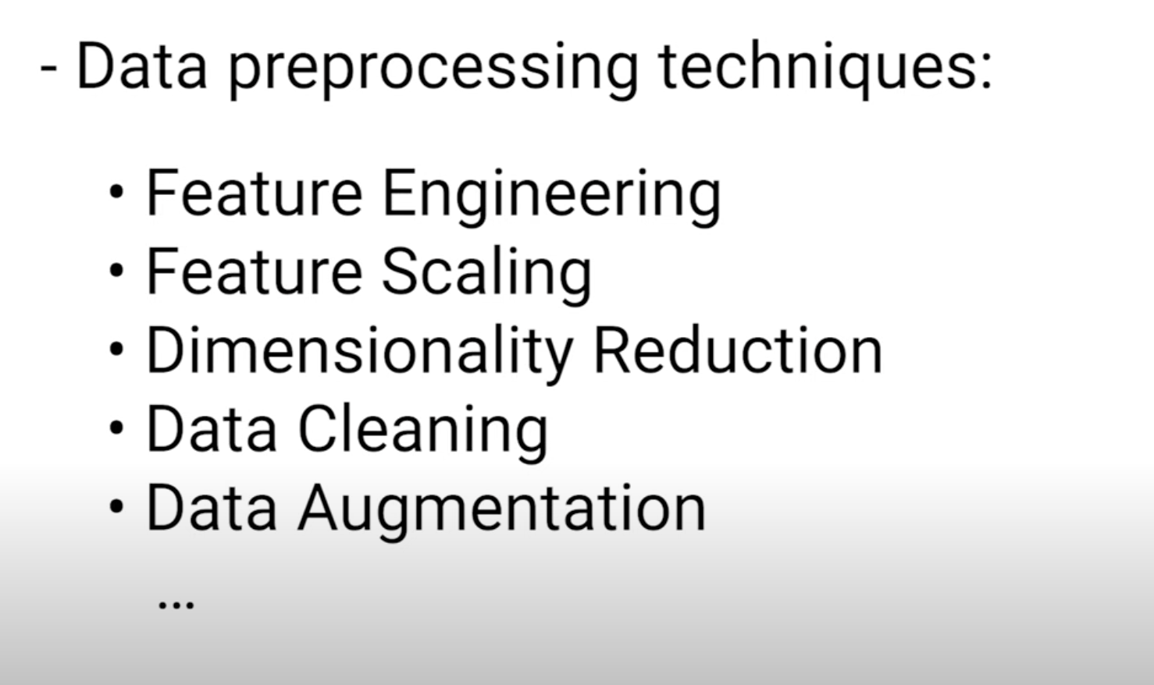
Data
Notes:
for
example here the numbers for salary are
much larger than those for age and
dominate the model fitting common
scaling methods include minmax
normalization thus scaling to a 0 to one
range as seen here or standardization
transforming to mean zero and standard
deviation one proper

Slide 45

Evaluation
Model selection
For any prediction problem, there are many algorithms and methods available - decision trees, random forests, neural networks, and more
Model evaluation and selection is done by evaluating model performance on a common test dataset
Notes:
evaluation helps determine whether a
model has truly learned use patterns or
has just memorized the training data
those were all basic machine learning
terms
Evaluating several models in a test set helps on model selection.
for classification model evaluation
might involve measuring accuracy
precision recall or F1 score
for
regression model it might use mean
squared error or R squar values this
process typically involves both
validation to tune the model during
development and testing using a
completely separate test set to get an
unbiased estimate of final performance

Slide 46
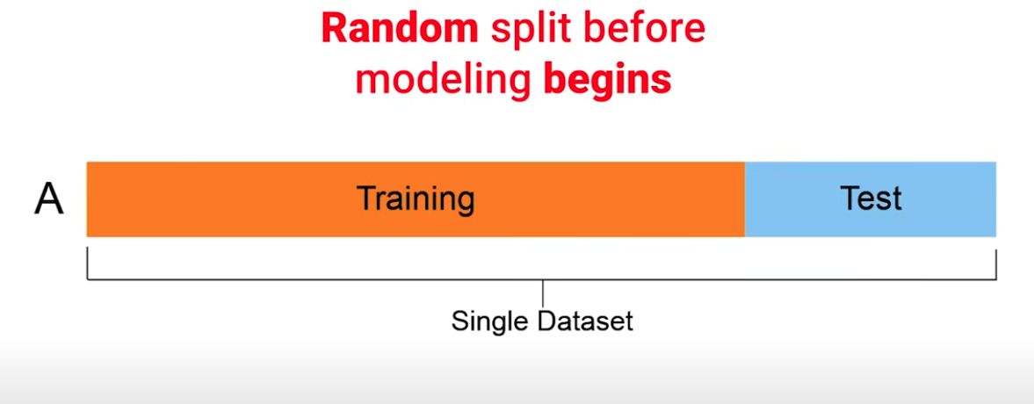




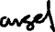
The Training and Testing Data Division
Notes:
a typical machine
learning data set consists of many such
instances which together form the
training or test data
fitting also called training or
learning is the process of adjusting a
model's parameters to find the best
match between the model's predictions
and the actual data if you think of
linear regression model fitting would be
trying out different lines until you
find the line with the best fit
training
data is a carefully selected subset of
data used to teach machine learning
models how to make predictions it
consists of input examples paired with
their correct outputs allowing the model
to learn patterns and relationships for
instance in an email spam filter the
training data would include thousands of
emails labeled as either spam or not
spam teaching the system to recognize
the characteristics of unwanted messages
similarly for an image recognition
system that identifies cats and dogs the
training data would contain numerous
images labeled as either cat or dog
helping the model learn the visual
patterns that Define what cats and dogs
look like
test data or test set is a
separate collection of data used to
evaluate how well a machine learning
model performs on examples it hasn't
seen during training like training data
it includes both inputs and their
correct answers
but these examples are kept completely
separate from the training process this
testing process helps verify whether the
model has truly learned to make good
predictions rather than just memorizing
its training examples importantly the
test and training data are separated
randomly before beginning the modeling
process so that the model can never see
the test data in any way before running
the final test
any inadvertent inclusion
of even parts of the test data in model
training is called Data leakage
Models are trained in batches
examples include
the learning rate batch size number of
epochs or the number of layers in a
neural network these are like the knobs
and dials that data scientists adjust to

Slide 47
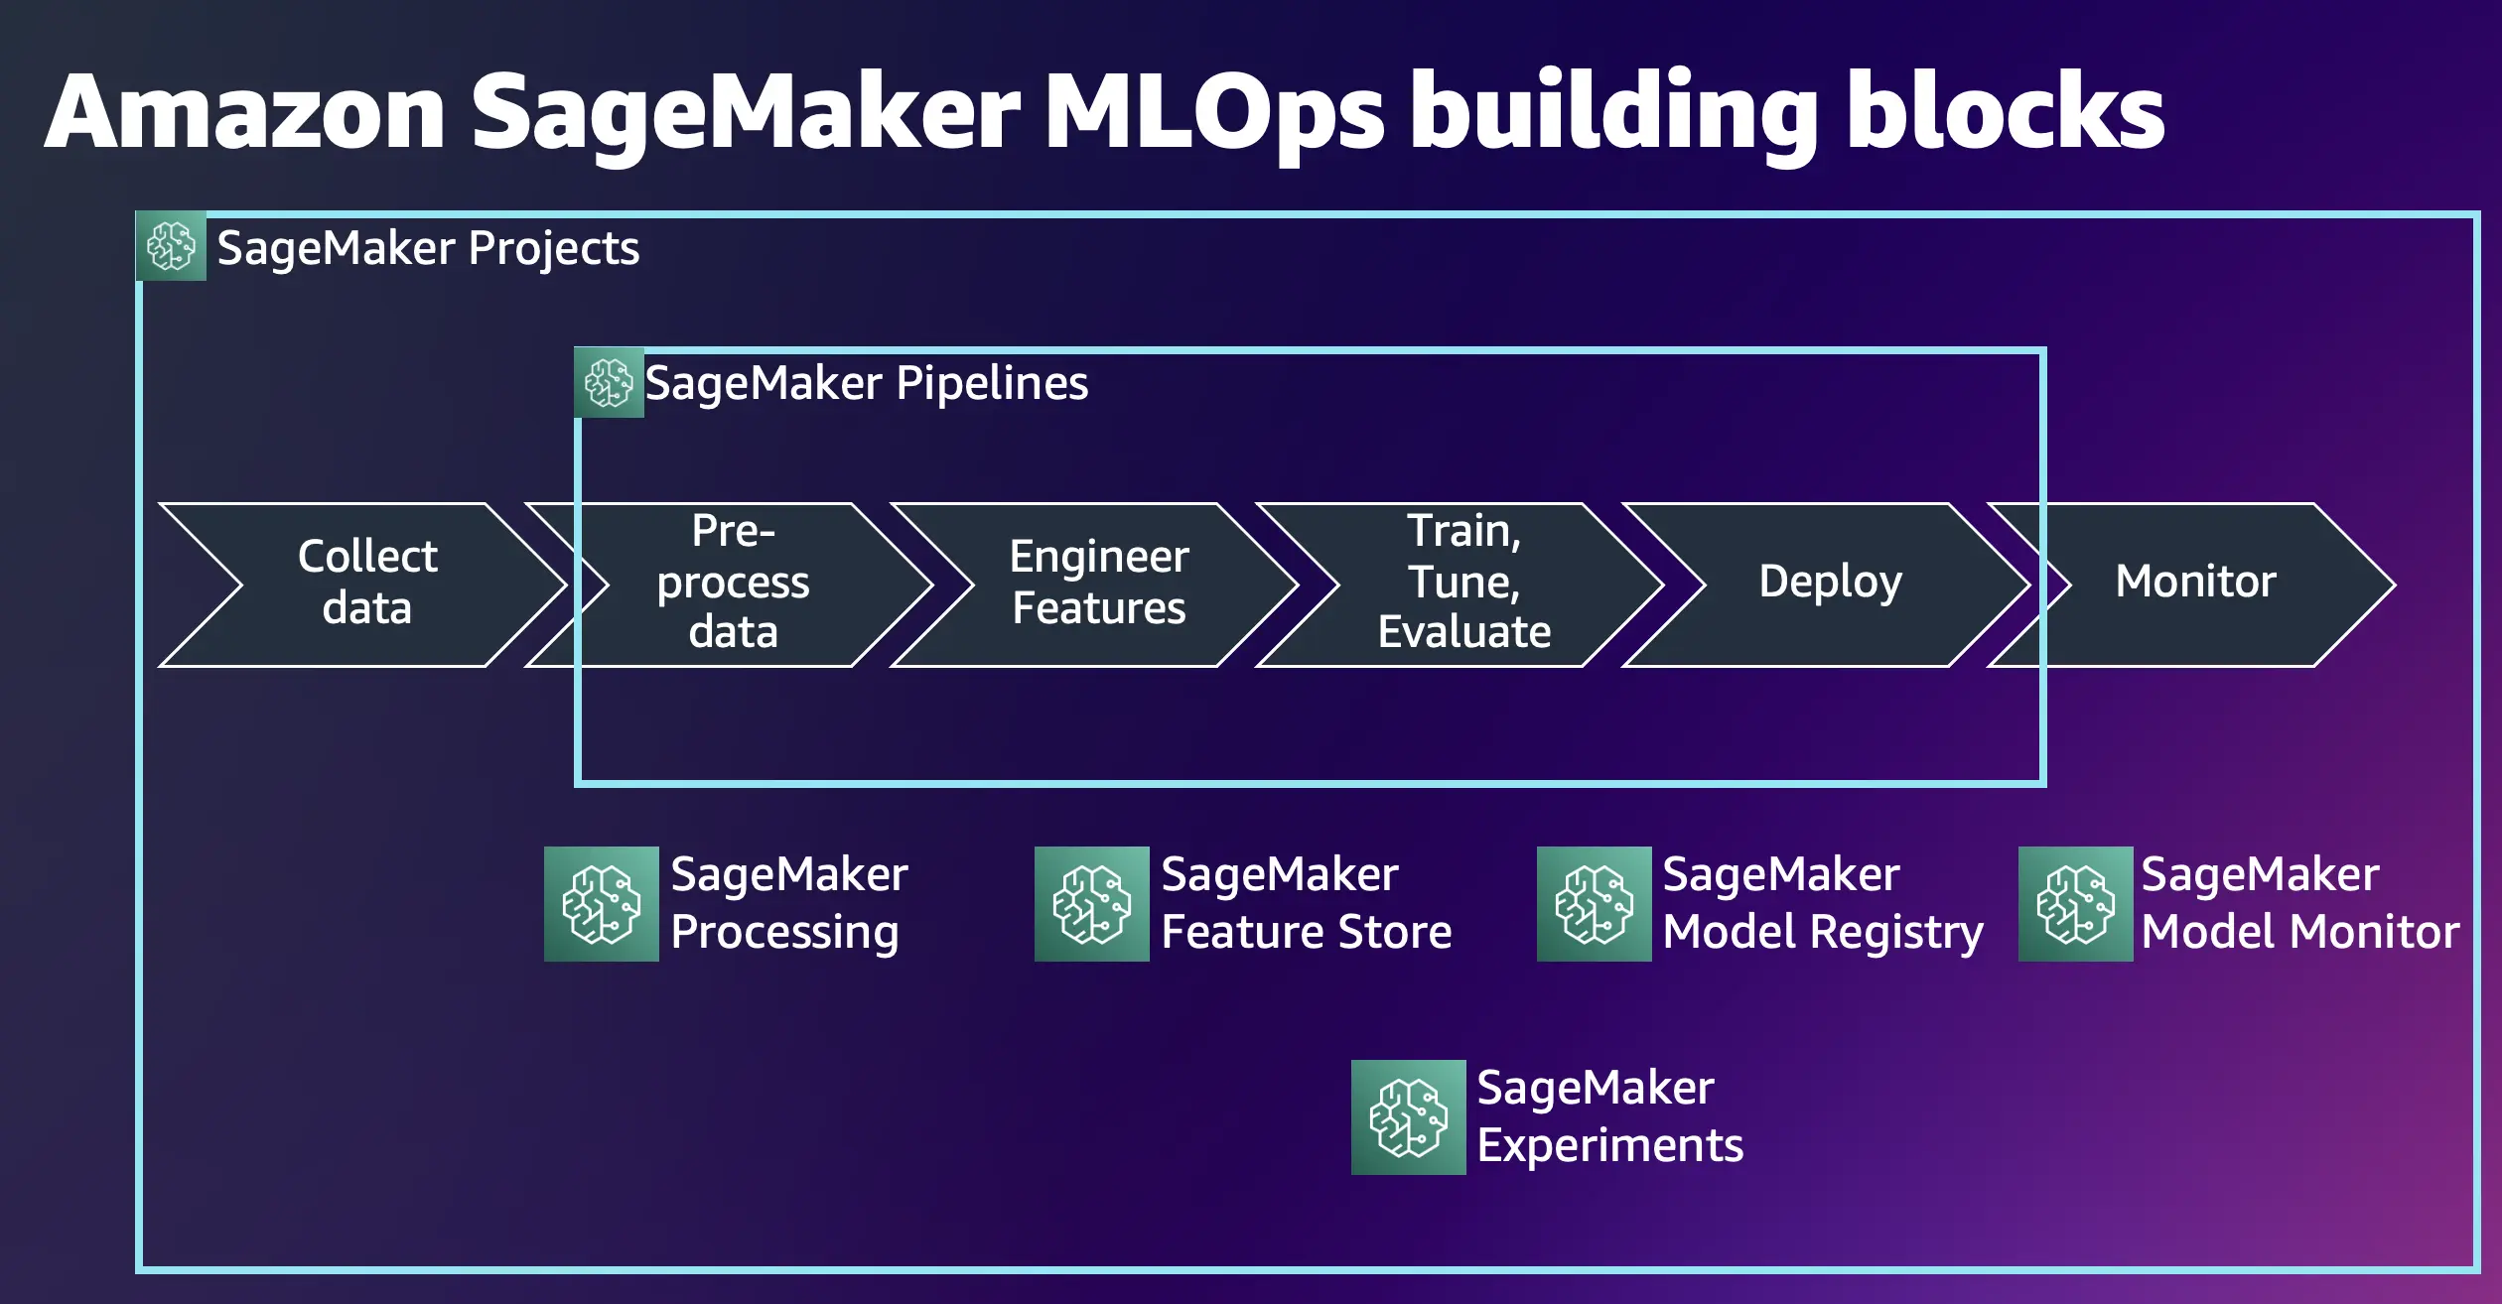
Feature Engineering
Example: Features you might you engineer from real estate pictures
Take individual images and extract individual features
Requires knowledge of real estate
Requires access to a realtor and a software developer
Good amount of guessing involved — very likely to miss critical features

